Slide 1
Namma Yatri – Technical Data Analysis

Slide 2
Objective
Objective: To uncover ride trends, booking behaviors, revenue drivers, and cancellations from Namma Yatri’s trip data.
Approach:
Merged 5 datasets using foreign keys (tripid, faremethod, loc_to)
Cleaned & enriched categorical data (duration labels, payment methods)
Performed Exploratory Data Analysis (EDA)
Visualized key insights using Python (Seaborn/Matplotlib)

Slide 3
Data Joins & Model
Join Structure:
Trip_Details ↔ Trips via tripid
Trips ↔ Duration via duration
Trips ↔ Payment via faremethod
Trips ↔ Assembly via loc_to
Result: A consolidated dataset with 983 records, capturing trip metadata, behavioral signals, payments, and location tags.

Slide 4
Variable Classification
Categorical: duration_label, payment_method, drop_zone
Numeric: fare, distance
Binary Flags: customer_not_cancelled, driver_not_cancelled, otp_entered, end_ride
Derived: Booking funnel stages, time-based demand

Slide 5
Ride Demand by Hour
Insight:
Clear peaks during 9–11 AM and 6–8 PM
Reflects commuter-based usage
Recommendation:
Align driver availability with demand zones during these windows

Slide 6
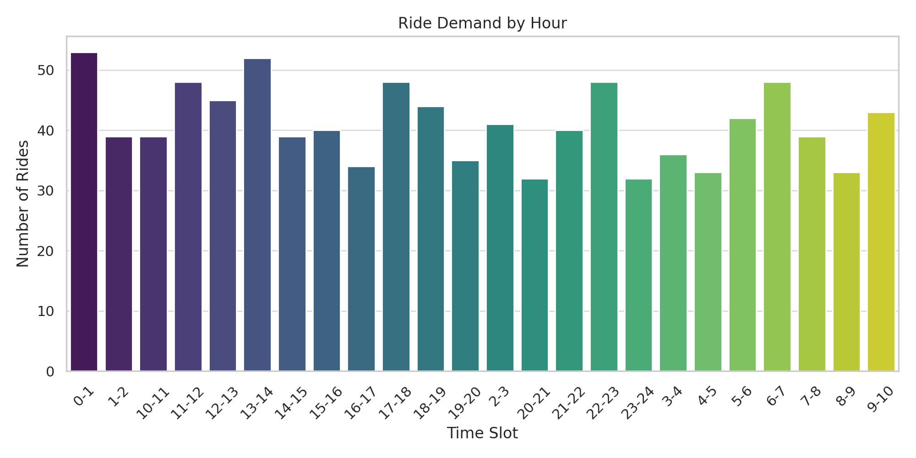
Ride Demand by hour

Slide 7
Revenue by Hour
Insight:
Revenue curve mirrors demand patterns
Midday dips in fare generation
Recommendation:
Consider time-based pricing or promos to flatten the revenue curve

Slide 8
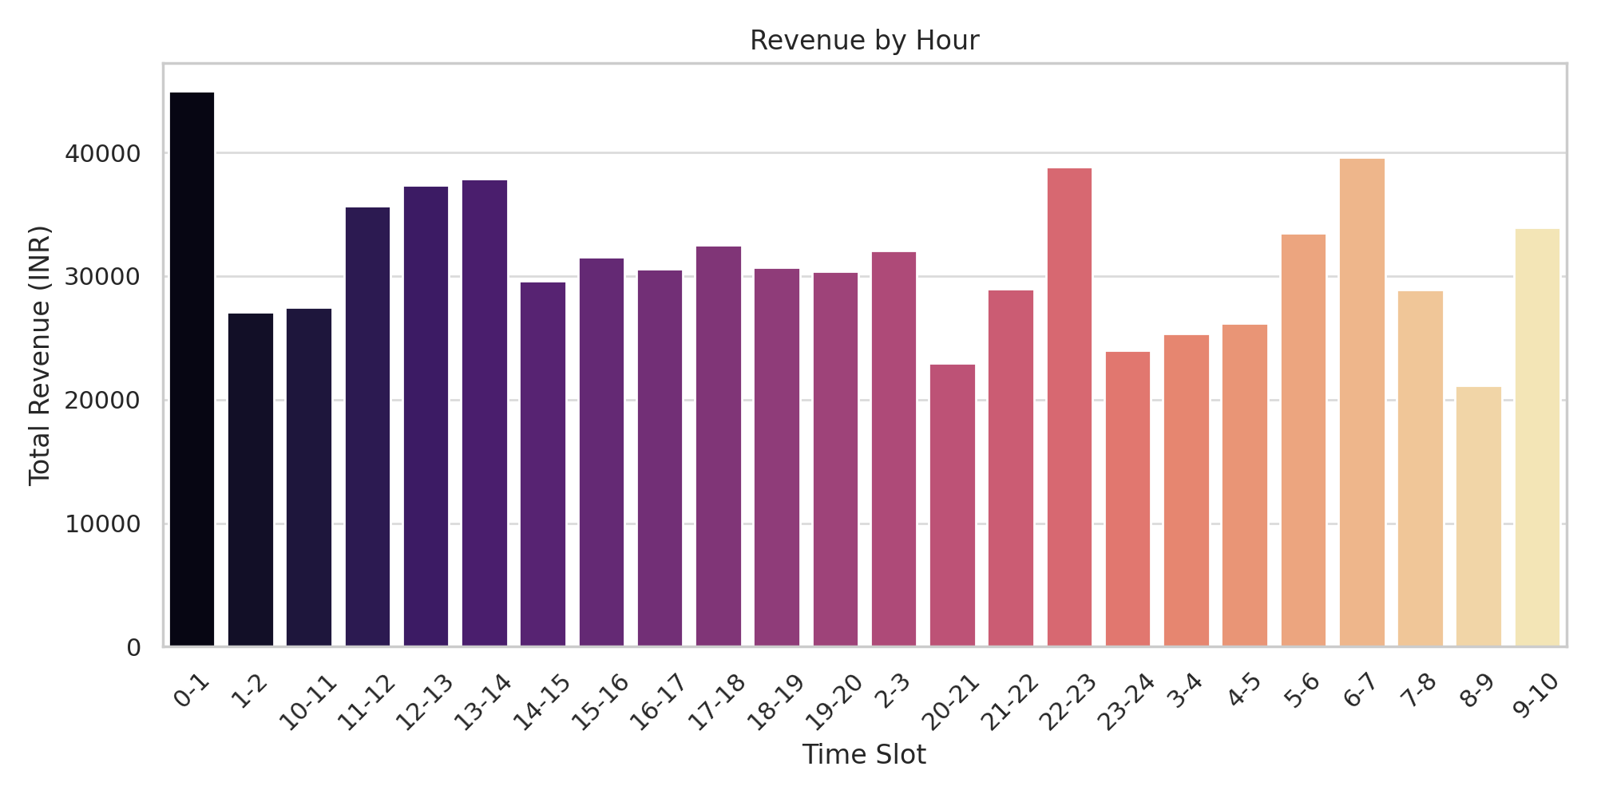

Slide 9
Payment Method Usage
Insight:
Equal distribution: Credit Card, UPI, Debit Card, and Cash
Note:
This is likely synthetic or balanced data
In real-world Indian mobility platforms, UPI and Cash dominate

Slide 10
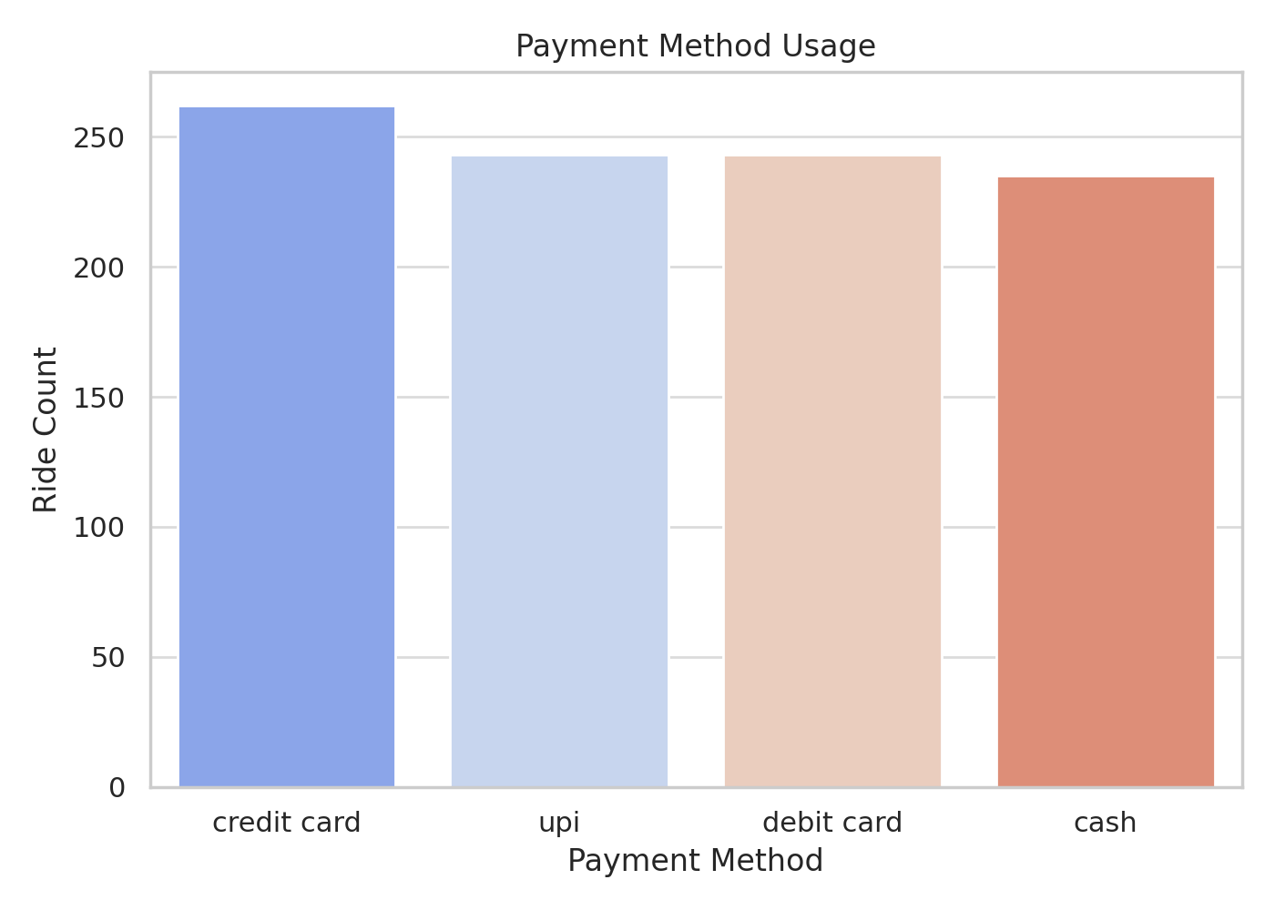

Slide 11
Cancellation Rate
Insight:
Customer cancellations: ~11%
Driver cancellations: ~7%
Root Cause Hypotheses:
Poor ETA estimates
Driver delays or user impatience

Slide 12
Top Pickup Zones (by Volume)
Insight:
5 zones account for ~30% of total ride volume
Recommendation:
Deploy higher driver density in these areas

Slide 13
Booking Funnel
Insight:
Large drop-off between “quote search” and “OTP entry”
Suggests user hesitation after viewing prices
Action:
Improve quote UX, show estimated time & driver reliability upfront

Slide 14
Quote-to-Completion by Hour
Insight:
Lower conversion rate during late-night hours
Recommendation:
Introduce driver incentives or discounts for late-night completions

Slide 15
Thank you
Sanjana Tadem tademsanjana57@gmail.com

